Slide 1
COMP 520 - Compilers
Lecture 13 – Branch Construction

Slide 2
PA3 Extension
Due on Friday 3/22 11:59pm
(Late penalty afterwards)
COMP 520: Compilers – S. Ali

Slide 3
Finally, PA4!
PA1: Large step into an unknown project
PA2: Comply with someone else’s code
PA3: Organize and finish the project (your code and theirs) to accomplish the goal of validating input source code
PA4: ?
COMP 520: Compilers – S. Ali

Slide 4
Finally, PA4!
PA1: Large step into an unknown project
PA2: Comply with someone else’s code
PA3: Organize and finish the project (your code and theirs) to accomplish the goal of validating input source code
PA4: Research the unknown, read documentation, and write the bytecode output!
COMP 520: Compilers – S. Ali

Slide 5
Today’s Goal
Implement:
if( ( a >= b ) == ( c < d ) ) {
a = 3;
b = 4;
}
COMP 520: Compilers – S. Ali

Slide 6
Today’s Goal
Implement:
if( ( a >= b ) == ( c < d ) ) {
a = 3;
b = 4;
}
Using Comparisons
Storing Comparisons
(for comparing later)
Conditional Execution
COMP 520: Compilers – S. Ali

Slide 7
Intermediate Goal
What does code generation look like?
COMP 520: Compilers – S. Ali

Slide 8
Intermediate Goal (2)
What does code generation look like?
General idea: Work on one section at a time.
COMP 520: Compilers – S. Ali

Slide 9
Intermediate Goal (3)
What does code generation look like?
General idea: Work on one section at a time.
Where is our code? Where is our data?
Don’t know, don’t need to know yet, first section we work on is generating “oblivious” incomplete code.
COMP 520: Compilers – S. Ali

Slide 10
Virtual Memory
What you could spend days/weeks on, gets two slides.
Access: 0x005418EF
Process 1 sees:
Memory Chunk: 00400000 – 007FFFFF
Translation Layer (Page Tables)
Physical Memory
Access: 0x7E1F 0000 0000 08EF
COMP 520: Compilers – S. Ali

Slide 11
Virtual Memory
What you could spend days/weeks on, gets two slides.
Access: 0x005418EF (same address as Proc1)
Process 2 sees:
Memory Chunk: 00400000 – 007FFFFF
Translation Layer (Page Tables)
Physical Memory
Access: 0x8E6F 0230 0000 08EF
COMP 520: Compilers – S. Ali

Slide 12
Variable References- Where?
If it is static, it is in either .bss or .data
-=-=-=-=-=-=-=-=-=-=-=-=-=-=-=-
Strategy: Pick a size for .bss, and assign each static variable an offset from the start of .bss
Then, pick a start address for .bss
E.g. “.bss starts in memory at 0x00400000”
COMP 520: Compilers – S. Ali

Slide 13
Where is .bss?
We can set it if we are an executable file
We don’t get to set it if we are a shared object.
A shared object is loaded “somewhere” in a parent process.
COMP 520: Compilers – S. Ali

Slide 14
Where is .bss?
We can set it if we are an executable file
We don’t get to set it if we are a shared object.
In the latter case, where is .bss?
How can I refer to 0x40408080C0C00000 + bssOffset when I don’t actually know where .bss starts from?
To test your researching capabilities, this will be a WA3 question (coming soon!)
COMP 520: Compilers – S. Ali

Slide 15
Executable Section
We won’t know the size of the executable section until we’re done.
We do need a start address though (unless .so)
-=-=-=-=-=-=-=-=-=-=-=-=-=-=-=-=-=-
Strategy: Pick “.text starts at 0x00800000”
Where we know the size of any previous sections.
COMP 520: Compilers – S. Ali

Slide 16
Code Generation
Strategy: Evaluate simple expressions with RAX
We will need additional complexity for PA4
COMP 520: Compilers – S. Ali

Slide 17
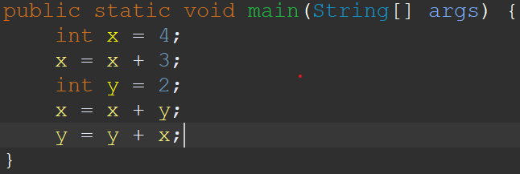
Code Generation Example
Visit Method
COMP 520: Compilers – S. Ali

Slide 18
Code Generation Example
Visit Stmt
COMP 520: Compilers – S. Ali

Slide 19
Code Generation Example
Variables
x | rbp-0 | ?
sub rsp,8
Create “x”
COMP 520: Compilers – S. Ali

Slide 20
Code Generation Example
Variables
x | rbp-0 | ?
sub rsp,8
mov rax,4
Visit Expr
COMP 520: Compilers – S. Ali

Slide 21
Code Generation Example
Variables
x | rbp-0 | 4
sub rsp,8
mov rax,4
mov [rbp],rax
Store
COMP 520: Compilers – S. Ali

Slide 22
Code Generation Example
Variables
x | rbp-0 | 4
sub rsp,8
mov rax,4
mov [rbp],rax
Visit Stmt
COMP 520: Compilers – S. Ali

Slide 23
Code Generation Example
Variables
x | rbp-0 | 4
sub rsp,8
mov rax,4
mov [rbp],rax
mov rax,[rbp]
add rax,3
Visit Expr
COMP 520: Compilers – S. Ali

Slide 24
Code Generation Example
Variables
x | rbp-0 | 7
sub rsp,8
mov rax,4
mov [rbp],rax
mov rax,[rbp]
add rax,3
mov [rbp],rax
Store
COMP 520: Compilers – S. Ali

Slide 25
Code Generation Example
Variables
x | rbp-0 | 7
sub rsp,8
mov rax,4
mov [rbp],rax
mov rax,[rbp]
add rax,3
mov [rbp],rax
Visit Stmt
COMP 520: Compilers – S. Ali

Slide 26
Code Generation Example
Variables
x | rbp-0 | 7
y | rbp-8 | ?
sub rsp,8
mov rax,4
mov [rbp],rax
mov rax,[rbp]
add rax,3
mov [rbp],rax
sub rsp,8
Create “y”
COMP 520: Compilers – S. Ali

Slide 27
Code Generation Example
Variables
x | rbp-0 | 7
y | rbp-8 | ?
sub rsp,8
mov rax,4
mov [rbp],rax
mov rax,[rbp]
add rax,3
mov [rbp],rax
sub rsp,8
mov rax,2
Visit Expr
COMP 520: Compilers – S. Ali

Slide 28
Code Generation Example
Variables
x | rbp-0 | 7
y | rbp-8 | 2
sub rsp,8
mov rax,4
mov [rbp],rax
mov rax,[rbp]
add rax,3
mov [rbp],rax
sub rsp,8
mov rax,2
mov [rbp-8],rax
Store
COMP 520: Compilers – S. Ali

Slide 29
Code Generation Example
sub rsp,8
mov rax,4
mov [rbp],rax
mov rax,[rbp]
add rax,3
mov [rbp],rax
sub rsp,8
mov rax,2
mov [rbp-8],rax
Variables
x | rbp-0 | 7
y | rbp-8 | 2
Visit Stmt
COMP 520: Compilers – S. Ali

Slide 30
Code Generation Example
sub rsp,8
mov rax,4
mov [rbp],rax
mov rax,[rbp]
add rax,3
mov [rbp],rax
sub rsp,8
mov rax,2
mov [rbp-8],rax
mov rax,[rbp]
add rax,[rbp-8]
Variables
x | rbp-0 | 7
y | rbp-8 | 2
Visit Expr
COMP 520: Compilers – S. Ali

Slide 31
Code Generation Example
sub rsp,8
mov rax,4
mov [rbp],rax
mov rax,[rbp]
add rax,3
mov [rbp],rax
sub rsp,8
mov rax,2
mov [rbp-8],rax
mov rax,[rbp]
add rax,[rbp-8]
mov [rbp],rax
Variables
x | rbp-0 | 9
y | rbp-8 | 2
Store
Flat assembler file is on the course website if you want it.
COMP 520: Compilers – S. Ali

Slide 32
Let’s see this in action.
Additionally, see how branching is done!
COMP 520: Compilers – S. Ali

Slide 33
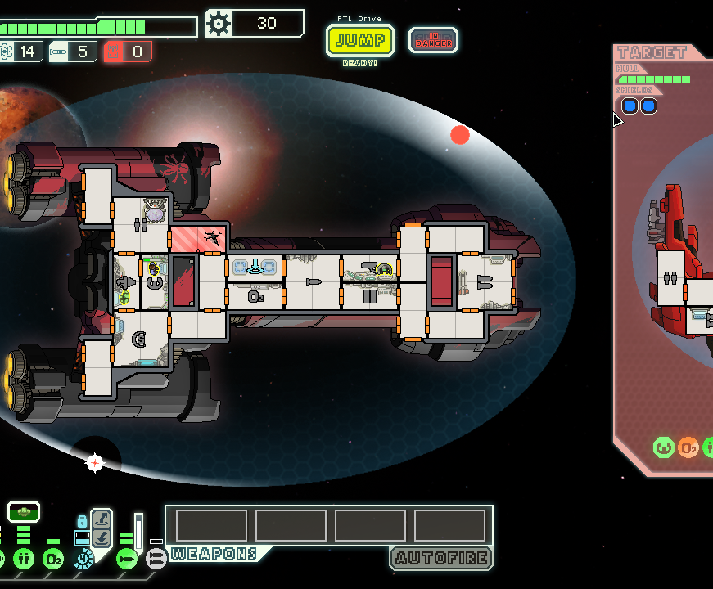
In-Class Demo
FTL: Faster Than Light
Goals: observe register and branch behavior

Slide 34
Generating Branches
COMP 520: Compilers – S. Ali

Slide 35
Condition
Recall: cmp a, b $≡$ set RFLAGS after “a-b”
COMP 520: Compilers – S. Ali

Slide 36
Conditions (S1)
( a >= b ) == ( c < d )
Strategy 1: Is there a way to get data out of the FLAGS and store them somewhere?
temp0 = a >= b
temp1 = c < d
temp0 = temp0 == temp1 cmp temp0,0
jnz …
COMP 520: Compilers – S. Ali

Slide 37
Conditions (S2)
( a >= b ) == ( c < d )
Strategy 2: Figure out a way to leave the last binary comparison, and utilize je at the very end
temp0 = a >= b
temp1 = c < d
cmp temp0,temp1
je …
COMP 520: Compilers – S. Ali

Slide 38
Conditions (S3)
( a >= b ) == ( c < d )
Strategy 3: use the conditional jumps themselves:
cmp a,b cmp c,d
jge isEqual jl isEq2
mov [rbp-04],0 mov [rbp-08],0
jmp End jmp End2
isEqual: mov [rbp-04],1 isEq2: mov [rbp-08],1
End: … End2: …
COMP 520: Compilers – S. Ali

Slide 39
Conditions (S3)
( a >= b ) == ( c < d )
Strategy 3 (continued):
…
mov rax,[rbp-04]
cmp rax,[rbp-08]
je finalIsEqual
COMP 520: Compilers – S. Ali

Slide 40
Strategy 3
This strategy isn’t wrong, just inelegant
Optimization is actually quite difficult
COMP 520: Compilers – S. Ali

Slide 41
What do you think?
What does the VisualC compiler do?
Strategy 1, 2, 3, or something else?
Or is it something so optimized that it would take an hour to analyze?
Taking guesses!
COMP 520: Compilers – S. Ali

Slide 42
What strategy is this?
COMP 520: Compilers – S. Ali

Slide 44
MSVC Used Strategy 3!!
Yes, that’s right
Throw out preconceived notions of elegant/inelegant
In the world of assembly, you do what works!
(And if in the business of optimization, you find the fastest operations, even if it is horribly inelegant)
COMP 520: Compilers – S. Ali

Slide 45
Organizing Assembly
We could spend an entire semester on optimization strategies where we just build the compiler more and more and more…
In the interest of time, you may want to take shortcuts in PA4. If it increases execution time by 40ns, the autograder won’t likely notice.
COMP 520: Compilers – S. Ali

Slide 46
Strategy 1 & 2 (Easy)
There are instructions that you can use
setz, setl, setle, setg, setge
COMP 520: Compilers – S. Ali

Slide 47
Strategy 1 & 2 (Easy)
There are instructions that you can use
setz, setl, setle, setg, setge
They will set a byte (al/cl/dl/bl/ah/ch/dh/bh) depending on if the flags are zero, less, …, etc.
But what if you didn’t see that documentation?
COMP 520: Compilers – S. Ali

Slide 48
More Registers?
Wait a minute, al/cl/dl/bl/ah/ch/dh/bh are not registers we have seen before!
COMP 520: Compilers – S. Ali

Slide 49
x64 General Purpose Registers Overview
Wait a minute, al/cl/dl/bl/ah/ch/dh/bh are not registers we have seen before!
RAX
64-bit
COMP 520: Compilers – S. Ali

Slide 50
x64 General Purpose Registers Overview
RAX …….
EAX
32-bit
64-bit
COMP 520: Compilers – S. Ali

Slide 51
x64 General Purpose Registers Overview
RAX …….
EAX …
AX
16-bit
32-bit
64-bit
COMP 520: Compilers – S. Ali

Slide 52
x64 General Purpose Registers Overview
RAX …….
EAX …
AX
8bit: AH AL
16-bit
32-bit
64-bit
COMP 520: Compilers – S. Ali

Slide 53
Useful Register List
64-bit | RAX |  | RCX |  | RDX |  | RBX |  | RSP | RBP | RSI | RDI
32-bit | EAX |  | ECX |  | EDX |  | EBX |  | ESP | EBP | ESI | EDI
16-bit | AX |  | CX |  | DX |  | BX |  | SP | BP | SI | DI
8-bit | AH | AL | CH | CL | DH | DL | BH | BL | ? | ? | ? | ?
Honorable Mentions: MM0, ST(0), XMM0, YMM0, ZMM0, CS, SS, DS, ES, FS, GS, GDTR, IDTR, TR, LDTR, CR, DR, IP…
COMP 520: Compilers – S. Ali

Slide 54
Useful Register List (2) (REX prefix)
64-bit | R8 | R9 | R10 | R11 | R12 | R13 | R14 | R15
32-bit | R8D | R9D | R10D | R11D | R12D | R13D | R14D | R15D
If operand R: REX.R, if R/M base: REX.B, if index: REX.X
Note: Flag REX.W has to be set to use 64-bit operands (RAX-R15) (otherwise it defaults to 32-bit operand EAX-R15D) We will cover encoding later.
COMP 520: Compilers – S. Ali

Slide 55
Back to the problem
This emulates what your googling might look like:
“Oh, I see something I haven’t seen before”
“I have now learned the new thing”
“How can I apply the new thing?”
COMP 520: Compilers – S. Ali

Slide 56
Back to the problem
We are currently after:
“I want to resolve a == b” to a value
COMP 520: Compilers – S. Ali

Slide 57
Back to the problem
We are currently after:
“I want to resolve a == b” to a value
I will XOR RAX,RAX (Why?)
I will CMP a,b
I will SETE al
Now RAX contains 0 or 1, depending on a==b
COMP 520: Compilers – S. Ali

Slide 58
Strategy 1 & 2 (Easy)
There are instructions that you can use
setz, setl, setle, setg, setge
They will set a byte (al/cl/dl/bl/ah/ch/dh/bh) depending on if the flags are zero, less, …, etc.
But what if you didn’t see that documentation?
COMP 520: Compilers – S. Ali

Slide 59
Strategy 1 & 2
There is an instruction that you can use
pushfq
It stores the RFLAGS data on the stack
From this, we can determine >=, <=, <, >, ==, !=
Example: [rsp] & 0x00C0
Same as “<=”
Why? (You will need to research RFLAGS)
COMP 520: Compilers – S. Ali

Slide 60
Strategy 1 & 2 (without SETLE)
if( [rsp] & 0x00C0 )
Any ideas on what the corresponding assembly looks like? Hint: cmp is not needed.
COMP 520: Compilers – S. Ali

Slide 61
Strategy 1 & 2 (without SETLE)
if( [rsp] & 0x00C0 )
Any ideas on what the corresponding assembly looks like? Hint: cmp is not needed.
and qword[rsp], 0xC0
jnz …
COMP 520: Compilers – S. Ali

Slide 62
Lastly: Conditional jump is misleading
if( cond )
StmtA
StmtB
More accurately: jump if the condition is NOT true.
So IfStmt will be: jmp if condition is false, otherwise continue to “ThenStmt”, then jmp past “ElseStmt”
Will see this in action in the next section
COMP 520: Compilers – S. Ali

Slide 63
What have we learned?
Evaluating the condition parameter will be challenging
But not intellectually difficult, just need to make sure your code “lines up” properly with what you want.
COMP 520: Compilers – S. Ali

Slide 64
Organizing Then/Else
COMP 520: Compilers – S. Ali

Slide 65
Two chunks of code
What to execute when the condition is true (if cond)
What to execute when the condition is false (else)
if( cond )
ThenStmt
(else ElseStmt)?
COMP 520: Compilers – S. Ali

Slide 66
Recall Demo Example
COMP 520: Compilers – S. Ali

Slide 67
Recall Demo Example
The “not true” portion of code is immediately after the “jump if true”
COMP 520: Compilers – S. Ali

Slide 68
Recall Demo Example
But we don’t always have an else statement!
COMP 520: Compilers – S. Ali

Slide 69
Misleading Conditions Part 1
if( x == 3 )
x = 4;
y = 3;
We have no else statement.
What if we branch on the same condition as our source code?
i.e., use “je” because we see “==”
COMP 520: Compilers – S. Ali

Slide 70
Misleading Conditions Part 1
if( x == 3 )
x = 4;
y = 3;
We have no else statement.
So the code could be:
cmp [x],3
je IsEq
jmp AfterEq
IsEq: mov [x],4
AfterEq: mov [y],3
COMP 520: Compilers – S. Ali

Slide 71
Misleading Conditions Part 2
if( x == 3 )
x = 4;
y = 3;
cmp [x],3
jne AfterIfStmt
mov [x],4
AfterIfStmt: mov [y],3
Less instructions is better!
COMP 520: Compilers – S. Ali

Slide 72
Misleading Conditions Part 3
if( x == 3 )
x = 4;
else
x = 5;
y = 3;
cmp [x],3
jne AfterIfStmt
mov [x],4
jmp AfterElseStmt
AfterIfStmt: mov [x],5
AfterElseStmt:mov [y],3
COMP 520: Compilers – S. Ali

Slide 73
Instruction Patching
But we do not know where an “AfterIfStmt” is!
Ideas?
COMP 520: Compilers – S. Ali

Slide 74
Instruction Patching (2)
But we do not know where an “AfterIfStmt” is!
Generate a placeholder conditional jump
E.g., jge 0x00000000
Keep track of where you have this placeholder
COMP 520: Compilers – S. Ali

Slide 75
Instruction Patching (3)
Generate a placeholder conditional jump
E.g., jge 0x00000000
Keep track of where you have this placeholder
Generate the “thenStmt” code
Finally, go back and patch “placeholder”
jge 0x00000000 -> jge 0x00001CF0
COMP 520: Compilers – S. Ali

Slide 76
PA3 Due soon, PA4 Next!
Don’t forget PA3!!
COMP 520: Compilers – S. Ali

Slide 77
End

Slide 78
COMP 520: Compilers – S. Ali

Slide 79
COMP 520: Compilers – S. Ali

Slide 80
COMP 520: Compilers – S. Ali

Slide 81
COMP 520: Compilers – S. Ali

